Slide 1
FIA Audit Trail Recommendations
February 26, 2020
U.S. Commodity Futures Trading Commission
Technology Advisory Committee (TAC) Meeting

Slide 2
Presenters
Tammy Botsford, Executive Director and Assistant General Counsel, J.P. Morgan
Mark Fabian, Vice President, Market Regulation, ICE Futures U.S.
Jeff Ramsey, Managing Director and General Counsel, Geneva Trading
Andrew Vrabel, Executive Director, Global Head of Investigations, CME Group

Slide 3
Background
FIA’s Audit Trail Working Group is comprised of representatives from the following communities:
Futures Commission Merchant (FCM)
Designated Contract Market (DCM)
Principal Trading Group (PTG)
In October 2018, representatives of the Working Group met with Commissioner Quintenz, as the Sponsor of the TAC, and senior members of CFTC staff, including DOE and DMO, to share their concerns regarding current audit trail requirements
In January 2020, the Working Group submitted a letter to Commissioner Quintenz and the Directors of DMO, DSIO, and DCR making four primary recommendations

Slide 4
Overview of Recommendations
Amend Regulation 38.553 to eliminate the requirement that DCMs conduct annual audit trail reviews
Amend Regulation 38.552 to remove the specific elements of an adequate transaction database
Confirm that DCMs may maintain records of Tier 1 Data on behalf of FCMs and other trading participants
DCMs should amend their rules to confirm that clearing FCMs do not have to maintain records of orders that are transmitted directly into the DCM trading system by direct access customers
We propose to modify certain aspects of Part 38, DCM-specific audit trail requirements only; we are not proposing any change to existing recordkeeping requirements prescribed by Regulations 1.31 or 1.35

Slide 5
Overview of Requirements
Regulations 1.31 and 1.35 require the retention and maintenance of records required to be made and kept in accordance with the CEA for a period of no less than 5 years, including order message and transaction data
All FCMs, retail foreign exchange dealers, certain introducing brokers, and members of DCMs are still required to maintain their respective audit trail records in accordance with Regulations 1.31 and 1.35
Regulations 38.551-553 pertain to audit trail requirements specific to DCMs

Slide 6
Regulation 38.551, Audit trail required
Regulation 38.551 requires that –
A [DCM] must capture and retain all audit trail data necessary to detect, investigate, and prevent customer and market abuses. Such data must be sufficient to reconstruct all transactions within a reasonable period of time and to provide evidence of any violations of the rules of the designated contract market. An acceptable audit trail must also permit the designated contract market to track a customer order from the time of receipt through fill, allocation, or other disposition, and must include both order and trade data.
The Working Group has confirmed with DMO staff that this requirement is specific to records of order and transaction messages received and sent by DCMs
DCMs do this today and FIA is not proposing any change to Regulation 38.551

Slide 7
Regulation 38.552, Elements of an acceptable audit trail program
Regulation 38.552 states that –
A [DCM’s] audit trail program must include an electronic transaction history database. An adequate transaction history database includes a history of all trades executed via open outcry or via entry into an electronic trading system, and all orders entered into an electronic trading system, including all order modifications and cancellations.
The Regulation then lays out specific data elements that must be included in a transaction history database, including CTI codes.

Slide 8
Regulation 38.553, Enforcement of audit trail requirements
Regulation 38.553 requires that a DCM must enforce its audit trail rules by conducting at least an annual review of all members, firms and persons subject to its recordkeeping rules to verify their compliance with the DCM’s audit trail and recordkeeping requirements
These audits must include “reviews of randomly selected samples of front-end audit trail data for order routing systems; a review of the process by which user identifications are assigned and user identification records are maintained; a review of usage patterns associated with user identifications to monitor for violations of user identification rules; and reviews of account numbers and customer type indicator codes in trade records to test for accuracy and improper use”
Current DCM annual audit trail review practices and components

Slide 9
Tier 1 vs. Tier 2 Data
For purposes of distinguishing the audit trail records required to be captured and maintained by DCMs versus the audit trail and recordkeeping requirements under Regulations 1.31 and 1.35, we will refer to the following:
“Tier 1 Data” – audit trail data that is captured and maintained by the DCM
“Tier 2 Data” – all order messages not included in the definition of Tier 1 Data that are required to be maintained pursuant to Regulations 1.31 and 1.35.

Slide 10
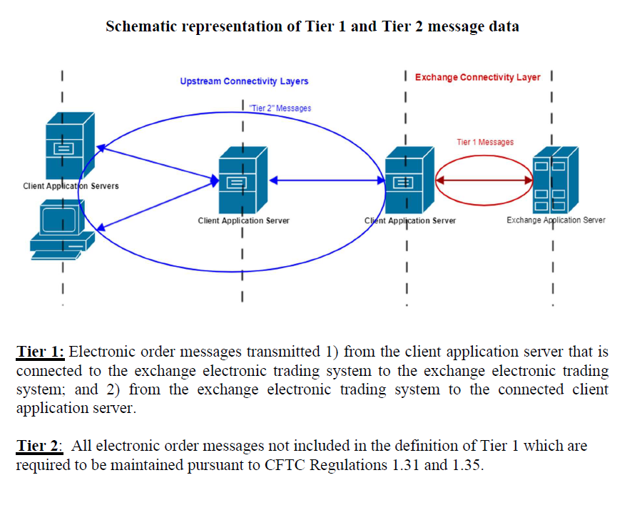
Tier 1 vs. Tier 2 Data (cont’d.)

Slide 11
Trade Practice Investigations
Tier 1 Data, which is not only highly granular but also uniform, is the foundation for the initiation of nearly every DCM trade practice investigation (99%)
Where Tier 2 Data is necessary for a trade practice investigation, a DCM can obtain that data from the respective firm or participant, where such firm or participant is required to maintain it

Slide 12
Example
A firm offers a front-end trading application to its clients
That trading application has functionality that allows clients to synthetically create iceberg orders, where only a portion of the total order quantity is displayed to the market at a time
A client electronically sends instructions to the trading application to sell 1,000 contracts (referred to as the “parent order”), displaying only 50 contracts (referred to as a “child order”) to the market at a time
The 50-lot child orders transmitted from the trading application to the exchange’s electronic trading system constitute Tier 1 Data
The client’s instructions to the trading application to sell 1,000 contracts as an iceberg order constitute Tier 2 data

Slide 13
Recommendations

Slide 14
1 – Eliminate Required Annual Audit Trail Reviews
Annual audit trail and recordkeeping reviews for electronic trading do not assist a DCM in preventing customer and market abuses since the same data is already a component of the DCM’s audit trail
Regulatory focus should be on DCM audit trail enforcement programs that review components of audit trail data for accuracy (e.g., reviews of user identifications and account numbers to test for accuracy and improper usage)
Industry benefits by eliminating non-value-adding work and reducing multiple redundant copies of audit trail records

Slide 15
2 – Remove Specific Elements of Adequate Transaction Database
The value of audit trail data elements changes over time (e.g., CTI codes have reduced in value, but Automated/Manual have increased)
This has rendered part of Regulation 38.552 (i.e., requiring CTI codes to be maintained) stale
The prescriptive components of Regulation 38.552 are also redundant since Core Principle 10 and Regulation 38.551 require DCM audit trail to be sufficient to reconstruct transactions, provide evidence of any violations, and track a customer order
Industry benefits with principles-based regulations that can more easily adapt to evolution

Slide 16
3 – DCMs Could Maintain Tier 1 Data on Behalf of
As DCMs are required to maintain Tier 1 Data to satisfy core principle and regulatory obligations, DCMs could offer a Tier 1 recordkeeping service to firms subject to Regulations 1.35 and 1.31
Industry benefits by reducing the number of redundant copies of Tier 1 Data, which is costly and presents risk, and better assuring consistency in audit trail data elements

Slide 17
4 – FCMs Not Required to Maintain Direct Access Orders
The Working Group recommends that DCM audit trail rules be amended so that a clearing FCM is not responsible for the maintenance of audit trail records for customers that directly access the DCM trading platforms without passing through the clearing FCM’s infrastructure
Regulation 1.35 reflects that records were originally created on paper to capture information on orders going into/fills coming out of the open outcry pits. Evolution has moved most records onto digital media (whether written or oral records) and trading itself has not only moved to computers, but has, in some cases, resulted in transactions flowing directly between the market participant and exchange. In DEA situations, no order is given to the FCM/clearing member; accordingly, the best source for that information is the relevant exchange.

Slide 18
Questions?

