Slide 1


Slide 2
Agency Deference No More? Lessons from West Virginia v. EPA
August 2022

Slide 3

Presenters
Host: Allison Lurton, Chief Legal Officers & General Counsel
David Applebaum, Partner, Energy, Jones Day
James Burnham, Partner, Issues & Appeals, Jones Day
Yaakov Roth, Partner, Issues & Appeals, Jones Day
Josh Sterling, Partner, Financial Markets, Jones Day
Presentation prepared by

Slide 4
West Virginia v. EPA and the Revolution in Administrative Law

Slide 5
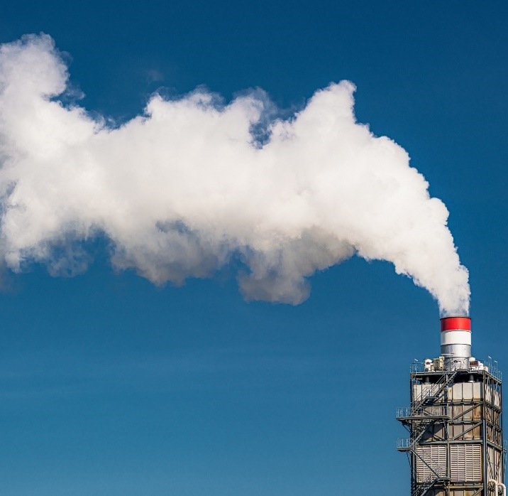
Clean Air Act
Clean Air Act authorizes EPA to regulate power plants by setting a “standard of performance” for air emission of pollutants. 42 U. S. C. § 7411(a)(1).
Standard must reflect the “best system of emission reduction” that is “adequately demonstrated” for a given type of power source. § 7411(a)(1), (b)(1), (d).
States then must regulate existing emission sources based on that standard.

Slide 6

Clean Power Plan
Clean Power Plan (2015) shifts focus from optimizing individual sources to instigating sector-wide shifts to cleaner energy (natural gas, wind, or solar).
Coal-fired plants must reduce electricity production or subsidize cleaner sources.
Estimated billions in compliance costs, closures of dozens of coal-fired power plants, and tens of thousands of job losses across various sectors.

Slide 7
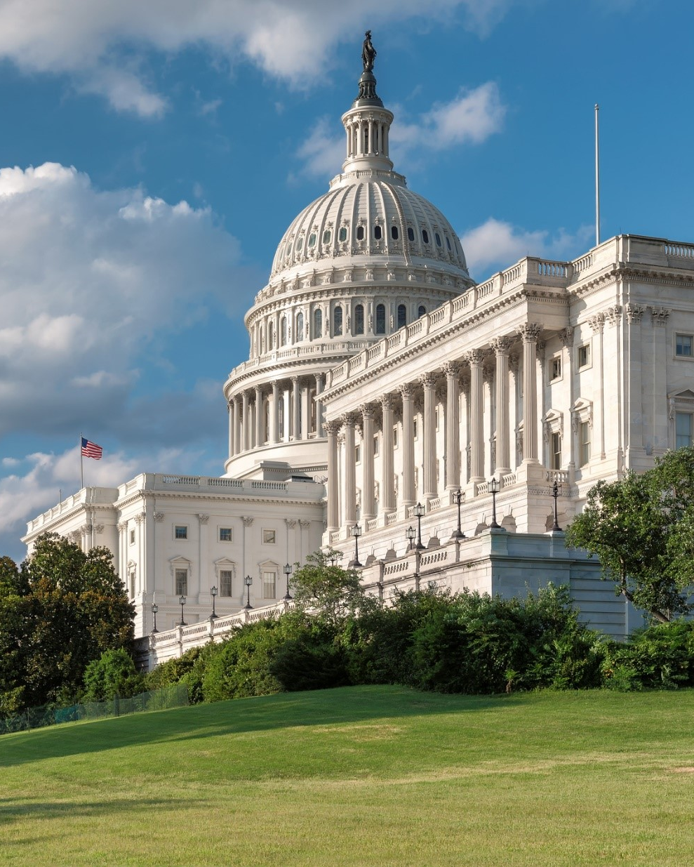
Major Questions Doctrine
“[A]dministrative agencies must be able to point to ‘clear congressional authorization’ when they claim the power to make decisions of vast ‘economic and political significance.’” (slip op., at 1) (Gorsuch, J., concurring).
“Extraordinary grants of regulatory authority are rarely accomplished through ‘modest words,’ ‘vague terms,’ or ‘subtle device[s].’ Nor does Congress typically use oblique or elliptical language to empower an agency to make a ‘radical or fundamental change’ to a statutory scheme.” (slip op., at 18.) (citations omitted).

Slide 8
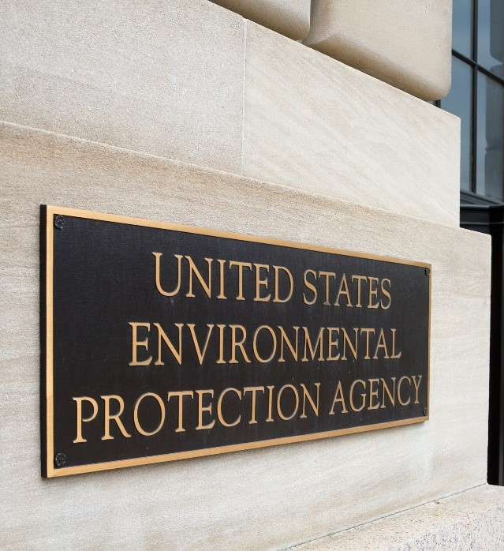
Application
“Under our precedents, this is a major questions case. In arguing that Section 111(d) empowers it to substantially restructure the American energy market, EPA ‘claim[ed] to discover in a long-extant statute an unheralded power’ representing a ‘transformative expansion in [its] regulatory authority.’ It located that newfound power in the vague language of an ‘ancillary provision[]’ of the Act, one that was designed to function as a gap filler and had rarely been used in the preceding decades. And the Agency’s discovery allowed it to adopt a regulatory program that Congress had conspicuously and repeatedly declined to enact itself. Given these circumstances, there is every reason to ‘hesitate before concluding that Congress’ meant to confer on EPA the authority it claims under Section 111(d).” (slip op., at 20) (citations omitted).

Slide 9
What Is a Major Question?
1
An agency claims to resolve matters of “great political significance” or issues part of an “earnest and profound debate across the country.”

Slide 10
What Is a Major Question?
1
An agency claims to resolve matters of “great political significance” or issues part of an “earnest and profound debate across the country.”
2
An agency seeks to regulate “a significant portion of the American economy” or require billions in spending by private individuals or entities.

Slide 11
What Is a Major Question?
1
An agency claims to resolve matters of “great political significance” or issues part of an “earnest and profound debate across the country.”
2
An agency seeks to regulate “a significant portion of the American economy” or require billions in spending by private individuals or entities.
3
An agency attempts to “intrude[e] into an area that is the particular domain of state law.”

Slide 12
When Does Congress Speak Clearly? Ask…
1
What is the provision’s “place in the overall statutory scheme”?

Slide 13
When Does Congress Speak Clearly? Ask…
1
What is the provision’s “place in the overall statutory scheme”?
2
What is the “age and focus” of the statute “in relation to the problem the agency seeks to address”?

Slide 14
When Does Congress Speak Clearly? Ask…
1
What is the provision’s “place in the overall statutory scheme”?
2
What is the “age and focus” of the statute “in relation to the problem the agency seeks to address”?
3
Has the agency interpreted this statute in the past?

Slide 15
When Does Congress Speak Clearly? Ask…
1
What is the provision’s “place in the overall statutory scheme”?
2
What is the “age and focus” of the statute “in relation to the problem the agency seeks to address”?
3
Has the agency interpreted this statute in the past?
Is there a “mismatch between an agency’s challenged action and its congressionally assigned mission and enterprise”?

Slide 16
Buildup to West Virginia v. EPA

Slide 17
Alabama Association of Realtors v. Department of Health and Human Services, 141 S. Ct. 2485 (2021)

Slide 18
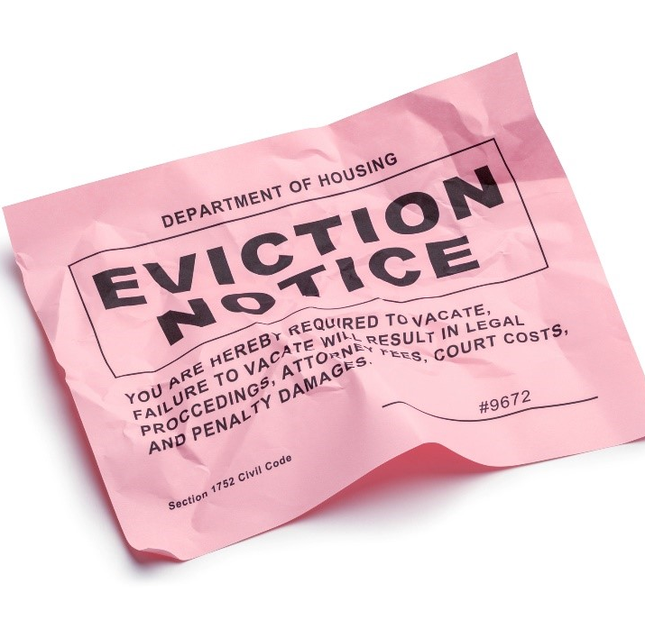
Nationwide Eviction Moratorium
Public Health Services Act authorizes CDC regulations
“to prevent the introduction, transmission, and spread of communicable diseases.” 42 U.S.C.
§ 264(a).
CDC imposes a nationwide eviction moratorium for all residential properties and criminally penalizes violators.
Mortarium covers at least 80% of the country and had an estimated impact of nearly $50 billion.

Slide 19
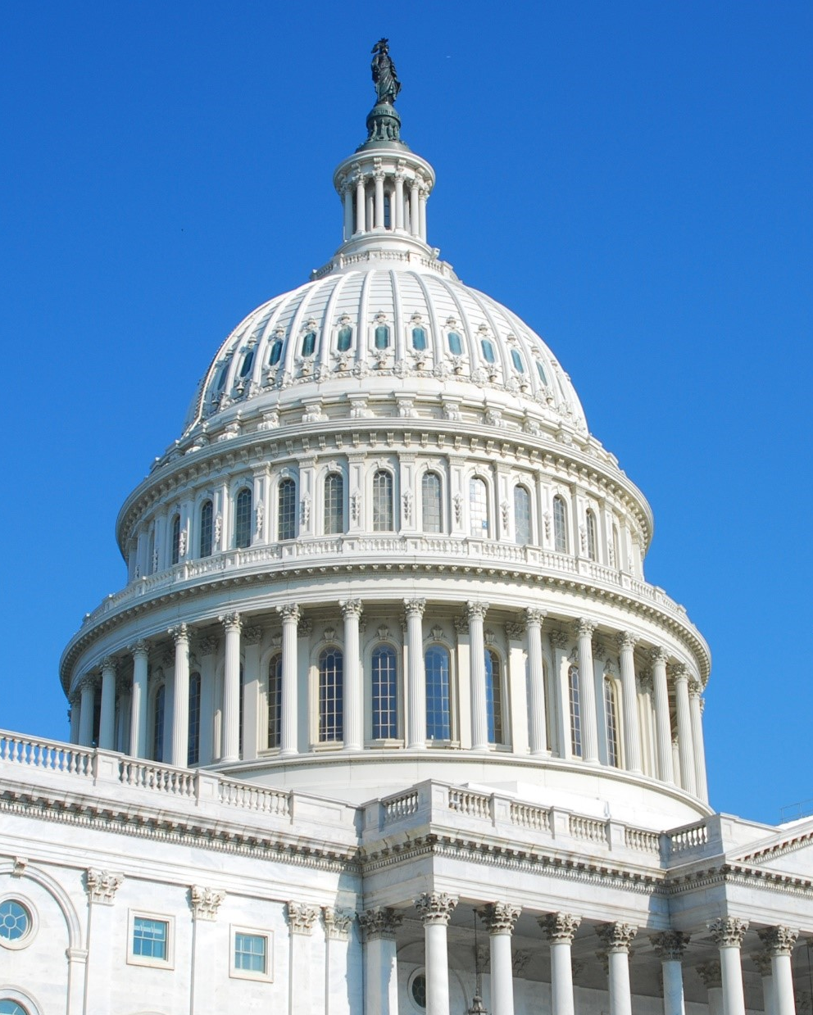
Traditional State Domain
“Our precedents require Congress to enact exceedingly clear language if it wishes to significantly alter the balance between federal and state power and the power of the Government over private property.” 2489 (citation omitted).

Slide 20
National Federation of Independent Businesses v. OSHA, 142 S. Ct. 661 (2022)

Slide 21

Vaccination Mandate
Occupational Health and Safety Act authorizes OSHA to ensure “safe and healthful working conditions.” 19 U.S.C. § 651(b).
OSHA issues an emergency rule requiring roughly 84 million employees to receive COVID-19 vaccination or test at their own expense.

Slide 22
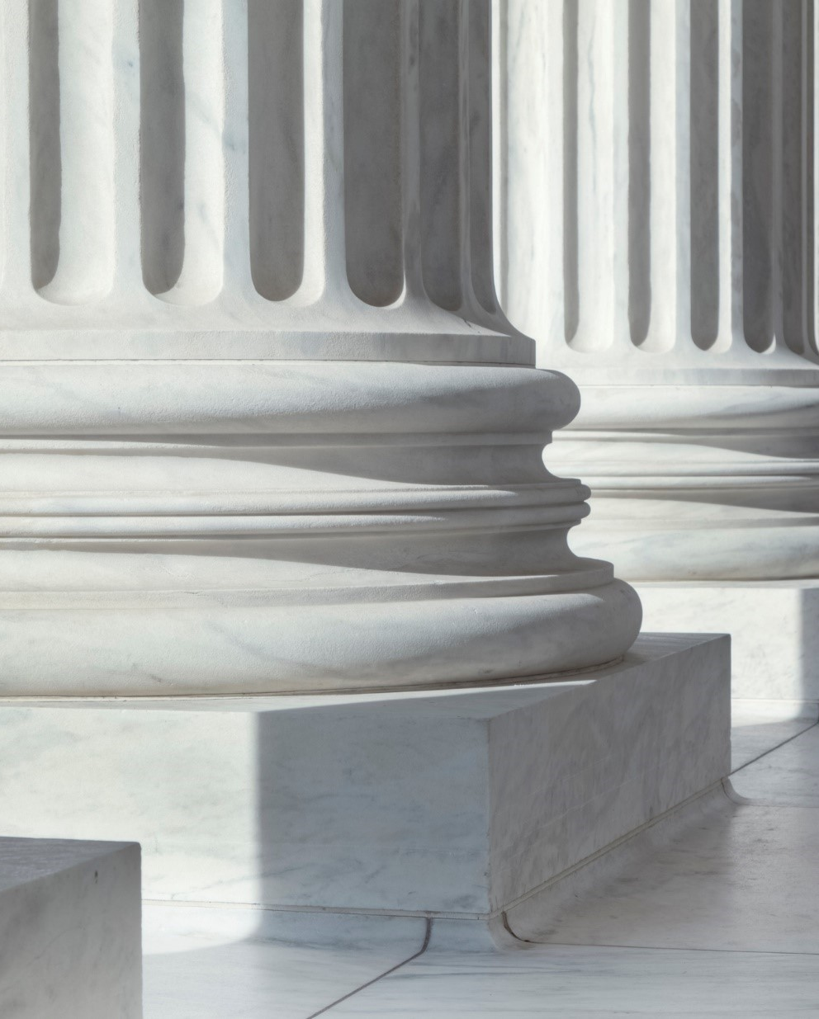
Vast Economic and Political Significance
“This is no ‘everyday exercise of federal power.’ It is instead a significant encroachment into the lives—and health—of
a vast number of employees. ‘We expect Congress to speak clearly when authorizing an agency to exercise powers of vast economic and political significance.’ There can be little doubt that OSHA’s mandate qualifies as an exercise of such authority.”
665 (citations omitted).

Slide 23

COVID Not A Workplace Standard
“The question, then, is whether the Act plainly authorizes the Secretary's mandate. It does not. The Act empowers the Secretary to set workplace safety standards, not broad public health measures. Confirming the point, the Act's provisions typically speak to hazards that employees face at work. And no provision of the Act addresses public health more generally, which falls outside of OSHA's sphere of expertise.” Id. (citations omitted).

Slide 24
SEC Proposed Climate Rules
Requires registrants to disclose climate-related information in registration statements and periodic reports, including direct, indirect, and upstream and downstream emissions.
Congress granted the SEC authority to promulgate regulations to protect investors and the public interest, not to compel registrants to inventory greenhouse gas emissions.
The Commission’s claim to authority over climate-related information is even more questionable given that Congress delegated authority to the EPA to regulate reporting of climate-related data, including greenhouse gas emissions.
West Virginia may make it difficult for the SEC to rely on an interpretation of an ambiguous statute to authorize the SEC’s Proposed Climate Rules, regardless of whether the SEC’s interpretation of its statutory authority is reasonable.

Slide 25
How the Major Questions Doctrine May Affect FERC Actions

Slide 26
FERC: Implications for Electric Matters
Federal Power Act gives FERC broad authority over:
  Transmission and wholesale sales in interstate commerce
  “Just and reasonable” and not “unduly discriminatory” rates
April 2022 FERC Transmission Notice of Proposed Rulemaking
  Builds on long line of FERC transmission planning jurisprudence
  More explicit in its focus on renewable resources
  Transmission plans must “meet transmission needs driven by changes in the resource mix and demand”
  Must consider federal, state, and local laws that affect the resource mix (e.g., renewable portfolio standards and regulations on electrification & decarbonization)

Slide 27
2022 FERC Transmission Proposed Rulemaking
This rule “seek[s] to use the FPA, a statute that sounds in rate regulation and reliability, as a tool to achieve a particular (and inapposite) policy goal.”
Commissioner Danly, dissenting
“Increased development and integration of renewable generation is a highly charged political question and a matter of significant political interest” and reflects “policy choices, not of Congress, but of particular state legislatures.”
The Utah Public Service Commission

Slide 28
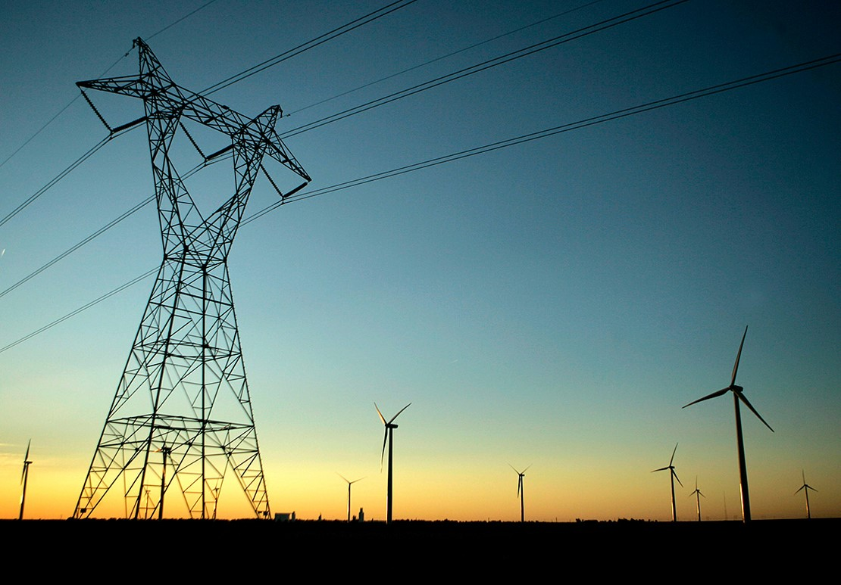
A Major Question: Resource Neutrality
“It is not the Commission’s role to choose one resource type over another, or to second guess the wisdom of state resource decision making. Instead, we must ensure, in a resource-neutral manner, that wholesale electricity markets are procuring the services needed to keep the lights on and the grid in balance. ”
- Chairman Glick (May 2022)

Slide 29
Natural Gas: FERC Authority Overview
Sections 3 and 7 of the Natural Gas Act (NGA)
  FERC has the authority to regulate the construction, development, and operation of certain LNG facilities and interstate pipelines
FERC issues certificates approving a project after:
  balancing of factors that affect the public interest
  environmental review consistent under the National Environmental Policy Act (NEPA).
FERC considers:
  the applicant’s existing customers;
  existing pipelines in the market and their captive customers; and
  landowners and communities affected by the proposed project

Slide 30
“Modernized” Policy Statements
(Draft) Updated Certificate Policy Statement (February 2022)
  FERC has expanded consideration of adverse community impacts to now include impacts on climate change.
(Draft) Interim GHG Policy Statement (February 2022)
  FERC to consider climate change, including GHG emissions, in its public interest determinations for jurisdictional LNG facilities and interstate pipelines under NGA sections 3 and 7
  Downstream consideration: whether there is a “substantial likelihood of GHG emissions from the end-use combustion of transported gas as a result of a natural gas project proposed under NGA section 7.”
  Upstream consideration: whether “the environmental effects from natural gas production are either likely caused by a proposed NGA section 7 project or reasonably foreseeable consequences of our approval of such projects.”

Slide 31
Exceeding Authority: Expected Challenges
Commissioner Christie Dissent:
  First, the Commission may not reject a certificate based solely on an estimate of the impacts of GHG emissions, indirect or direct.
  Second, the Commission can consider the direct GHG impacts of the specific facility for which a certificate is sought, just as it analyzes other direct environmental impacts of a project.
  Third, the Commission may not impose conditions on a certificate to mitigate upstream or downstream GHG emissions arising from non-jurisdictional activity.

Slide 32
“Modernized” Policy Statements
“The fundamental changes the majority imposes today to the Commission’s procedures governing certificate applications are wrong as both law and policy. They clearly exceed the Commission’s legal authority under the NGA and NEPA and, in so doing, violate the United States Supreme Court’s major questions doctrine.”
- Commissioner Christie, dissenting
“While I agree that reducing carbon emissions that impact the climate is a compelling policy goal, this Commission—an administrative agency that only has the powers Congress has explicitly delegated to it—has no open-ended license under the U.S. Constitution or the NGA to address climate change or any other problem the majority may wish to address.”
- Commissioner Danly, dissenting

Slide 33
How the Major Questions Doctrine May Affect Potential CFTC Actions

Slide 34
The Current Commission
Year one under Chairman Behnam consisted mostly of staff actions and the enforcement results, as would be expected given Commission-level vacancies.
Year two, with four new Commissioners on hand, has reflected much of the same so far.
All the Commissioners are finding their own lanes on policy issues, making clear that their voices will be heard on many critical fronts.
Of course, we are all expecting more significant Commission action—orders and rulemakings—to start coming soon.

Slide 35

Looking Ahead
Commission action may be difficult in certain areas following the West Virginia v. EPA decision, given limited statutory authority in the CEA.
Key areas we are watching include the following:
  Climate Risk
  Voluntary Carbon Markets
  Digital Assets
  System Safeguards

Slide 36

Climate Risk
The CFTC’s Climate Risk Unit is pursuing an “all of agency” approach to addressing how climate change may affect the financial system.
This preceded and mirrors the Executive Order on climate risk in the financial system.
No concrete actions have been announced yet.
To withstand court scrutiny, however, those actions will need to be tied to specific statutory language.

Slide 37

Voluntary Carbon Markets
The CFTC recently concluded its first Voluntary Carbon Markets Convening.
These discussions are intended to identify ways to further the standardization and development of carbon markets.
There is a fine line to walk between promoting “best practices” and promulgating rule-like standards without appropriate process, however.

Slide 38

Digital Assets
The CFTC has brought over 50 enforcement actions in the digital assets space.
It has also issued interpretive guidance relevant to digital asset derivatives and “actual delivery” of digital assets.
There is a broad understanding that the CFTC will need express authority to regulate “spot” digital assets markets in the same way that it does the derivatives markets.
Whether Congress and the White House will deliver such legislation anytime soon is anyone’s guess.

Slide 39

System Safeguards
The CFTC may propose system safeguard requirements for SDs and FCMs.
However, with two exceptions, the CEA does not require system safeguards rules for SDs, FCMs, or other registrants.
The CEA expressly requires system safeguards for DCMs and SEFs.
Rulemaking in this area therefore could face difficulty if scrutinized under the major questions doctrine.

Slide 40
Paradigm Reset Going Forward
We do not expect the Commission to break from its deliberative and thoughtful tradition anytime soon.
The Commission does have an aggressive agenda, and where specific actions lack express statutory approval, they will be at risk for potential court challenge.
Without question, West Virginia v. EPA will make it harder for the CFTC to take action under general statutory language, like Section 8a(5), than ever before.

Slide 41
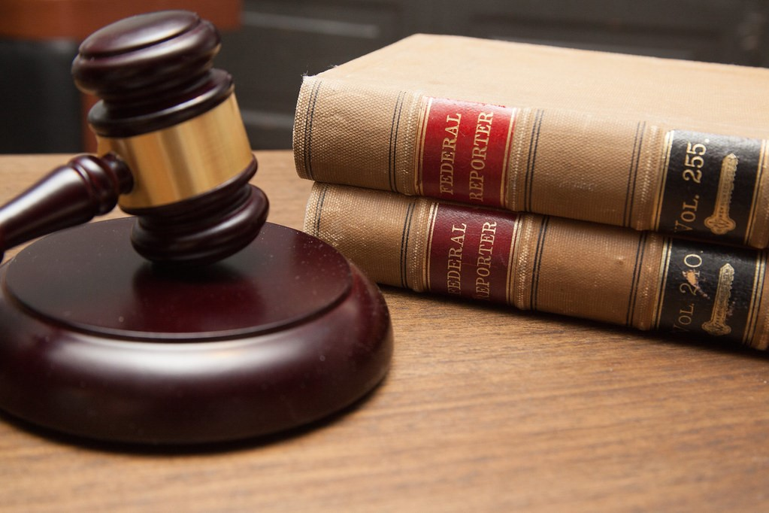
Postscript: Remember Position Limits Litigation?
In ISDA v. CFTC, the DC District Court remanded position limits rules to the CFTC to make findings required by Section 4a of the CEA.
The court found that the statue clearly and unambiguously required those findings under a Chevron analysis.
This case is an important reminder that agency action can be fraught with litigation risk, even where the dispute is over how to interpret specific statutory language.

Slide 42
Looking Ahead: Other Issues

Slide 43
Jarkesy v. SEC, 34 F. 4th 446 (5th Cir. 2022)

Slide 44
Three Constitutional Problems
1
SEC’s in-house adjudication of securities fraud case violated the Seventh Amendment right to a jury trial.

Slide 45
Three Constitutional Problems
1
SEC’s in-house adjudication of securities fraud case violated the Seventh Amendment right to a jury trial.
2
Congress unconstitutionally delegated legislative power by giving the SEC unguided discretion to choose whether to bring enforcement in Art. III court or within the agency.

Slide 46
Three Constitutional Problems
1
SEC’s in-house adjudication of securities fraud case violated the Seventh Amendment right to a jury trial.
2
Congress unconstitutionally delegated legislative power by giving the SEC unguided discretion to choose whether to bring enforcement in Art. III court or within the agency.
3
SEC ALJs’ for-cause removal restrictions violate Article II.

Slide 47
Thank you to our presenters!
Host: Allison Lurton, Chief Legal Officers & General Counsel
David Applebaum, Partner, Energy, Jones Day
James Burnham, Partner, Issues & Appeals, Jones Day
Yaakov Roth, Partner, Issues & Appeals, Jones Day
Josh Sterling, Partner, Financial Markets, Jones Day
Presentation prepared by

Slide 48

Thank you for joining us today!
Upcoming Webinar:
Arbitrations: From the Starting Gate to the Finish Line
10:00 – 11:00 AM ET
SEP
22

